Slide 1
Improvement Study towards
Few-Shot Medical
Image Segmentation
Group
LUO, Yichen
WANG, Yichao
YANG, Fengshuo

Slide 2
⇨ Related Work

Slide 3
Background
Few-Shot Medical Image Segmentation (FSMIS)
FSMIS enables training segmentation models with limited annotated medical images, addressing the critical challenge of scarce expert annotations in clinical practice.
It uses meta-learning to quickly adapt to new anatomical structures from just a few examples, making it valuable for rare diseases and resource-limited settings.

Slide 4
Background
Challenges in FSMIS
FSMIS faces key limitations:
(1) severe foreground-background class imbalance causing biased predictions
(2) blurred organ boundaries with low contrast

Slide 5
Background
Challenges in FSMIS
(3) inadequate feature learning from few samples
(4) prototype generation methods that overlook critical boundary information.
These issues result in poor boundary segmentation, weak small-structure detection, and limited generalization to new imaging conditions.

Slide 6
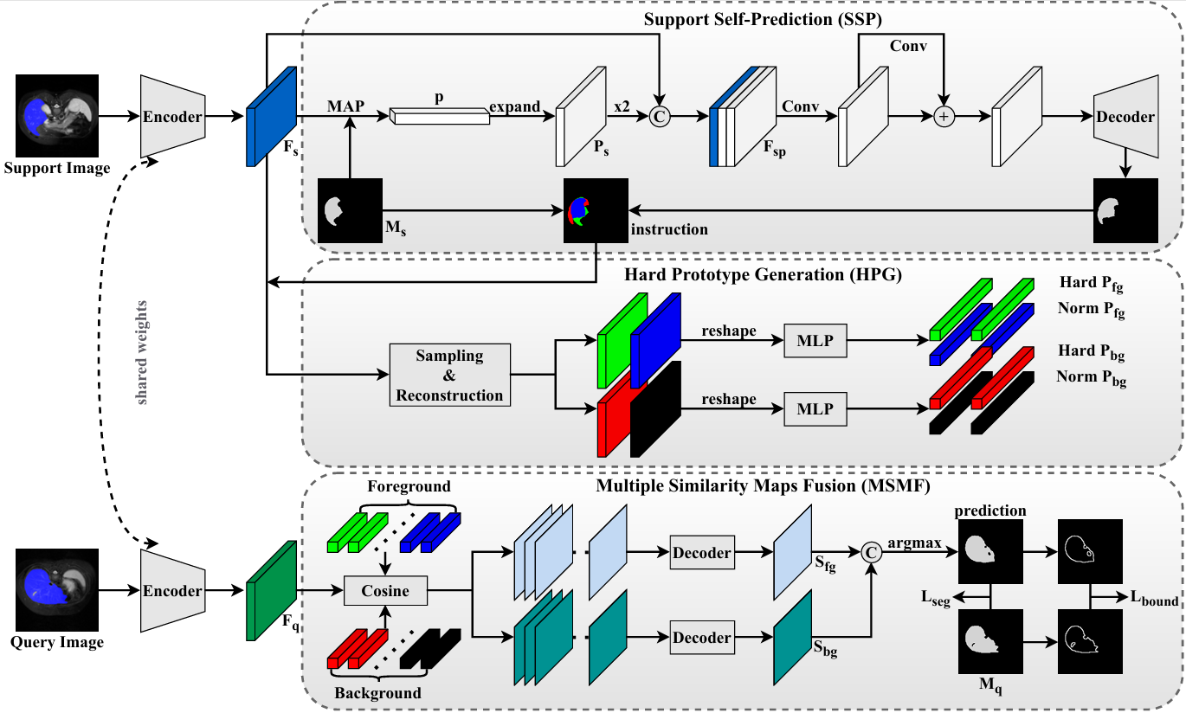
Baseline
CoW Framework Architecture
CoW is a few-shot medical segmentation framework that targets boundary ambiguity by focusing on "weak" boundary features.
A dual-path architecture, one for segmenting foreground
regions and the other for background.
Its core includes three modules:

Slide 7
Module
SSP
HPG
MSMF
Support Self-prediction (SSP)
identifies "weakness" regions by performing self-prediction and comparing it with the ground truth.
Hard Prototype Generation (HPG)
extracts specialized features from identified weakness areas to generate discriminative "hard prototypes" for feature enhancement.
Multiple Similarity Maps Fusion (MSMF)
fuses similarity maps from both base and hard prototypes to rectify biases and produce the final segmentation.

Slide 8
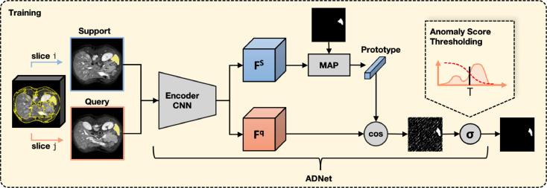
Pipeline
Abd MRI
Abd CT
CMR MRI
Improvement Methods Applied
Loss Function :
the segmentation loss
the prototype alignment regularization loss
the intra-class loss
the interclass loss
the boundary loss
Supervoxels
Segmentation
DS
Pre-processing
Training
Network
Predictor
Evaluation Metrics:
the mean Sorensen-Dice coefficient (DSC) to compare the prediction to the ground truth.

Slide 9
Limitation
SSP
HPG
MSMF
1.Prototypes are learned exclusively from support images
2.No mechanism to incorporate query-specific information
1. Hard pixels are sampled randomly from error regions
2. Treats all hard pixels equally, regardless of difficulty
3. Ignores uncertainty distribution within hard regions
1. Fusion is performed via a decoder-based black-box module
2. Lacks explicit modeling of prototype importance

Slide 10
⇨ Improve Ideas

Slide 11
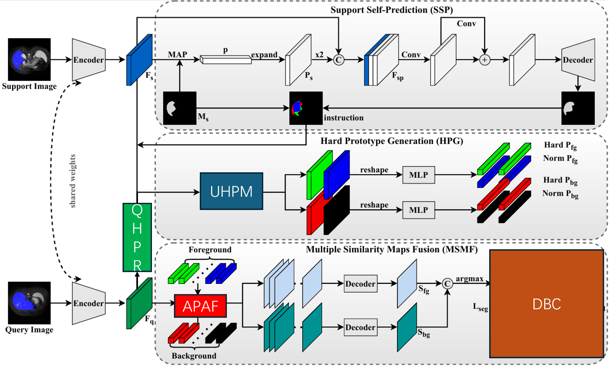
Innovation
Query-aware Hard Prototype Refinement
(QHPR)
Adaptive Prototype Attention Fusion
(APAF)
Uncertainty-weighted Hard Prototype Mining
(UHPM)
Distance-aware Boundary Constraint (DBC)

Slide 12
Innovation
Query-aware Hard Prototype Refinement
Refines prototypes using uncertain regions from the query image. Instead of relying solely on support, it introduces a closed-loop process to adapt prototypes to query-specific variations. This improves robustness in ambiguous and hard-to-segment regions.
Adaptive Prototype Attention Fusion
Replaces decoder-based fusion with an attention mechanism. Each pixel dynamically assigns weights to different prototypes based on its feature similarity. This enables interpretable and spatially adaptive fusion.

Slide 13
Innovation
Uncertainty-weighted Hard Prototype Mining
Selects hard pixels based on uncertainty rather than random sampling. More informative and ambiguous regions are prioritized during prototype construction. This leads to more discriminative and reliable prototypes.
Distance-aware Boundary Constraint
Introduces signed distance maps to provide geometry-aware supervision. It captures both boundary location and distance information. This improves structural consistency and boundary accuracy.
Notes:
Instead of randomly sampling hard pixels, we first compute an uncertainty map from the prediction.
Then we sample pixels with higher uncertainty more frequently, since they are more informative.
This leads to better and more reliable prototypes, especially in difficult regions.

Slide 14
⇨ Experiment

Slide 15
Implementation Details
Hardware: 1 × NVIDIA H800 GPU
Framework: PyTorch
Training iterations: 40,000
Epoch size: 5,000 iterations
Learning rate schedule: exponential decay (0.98)
Checkpoint interval: 5,000 iterations
Data loading workers: 16
Random seed: 2025

Slide 16
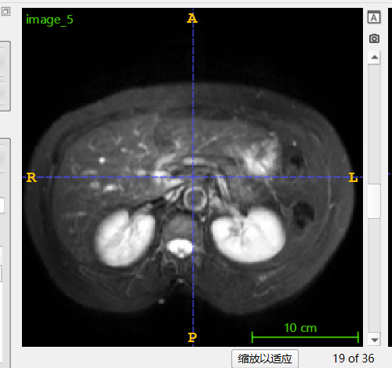
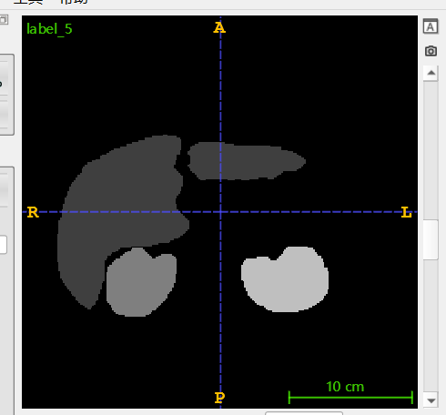
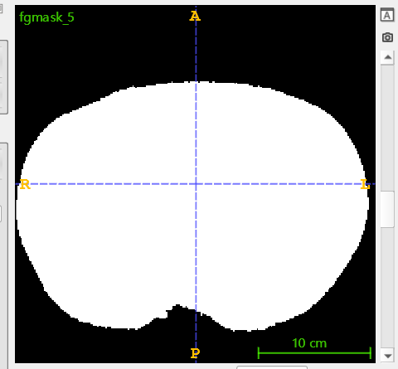
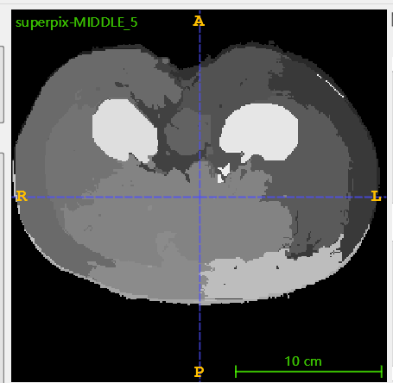
Dataset Preparation
Abd-MRI: named CHAOST2
Combined Healthy Abdominal Organ Segmentation data set
(same as baseline)
1——image
2——label
3——mask
4——superpixel

Slide 17
Quantitative Metrics

Slide 18
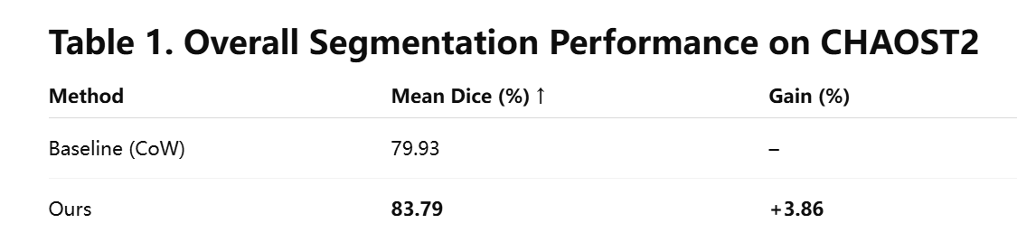
the mean Sorensen-Dice coefficient (DSC)
to compare the prediction to the ground truth.

Slide 19
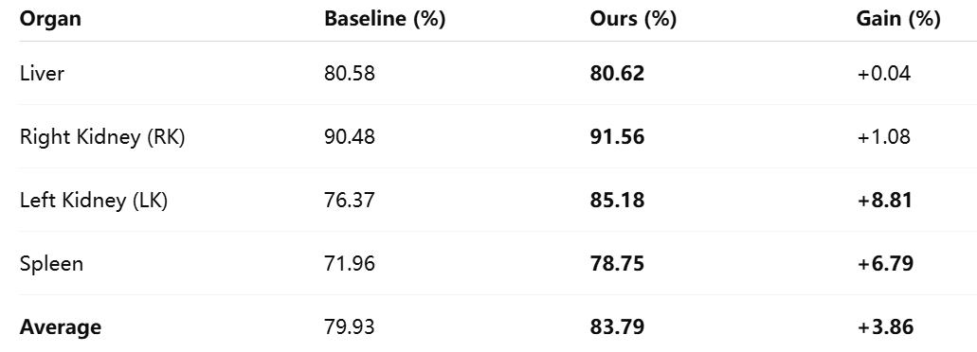
Table 2. Segmentation Performance by Organ on CHAOST2

Slide 20
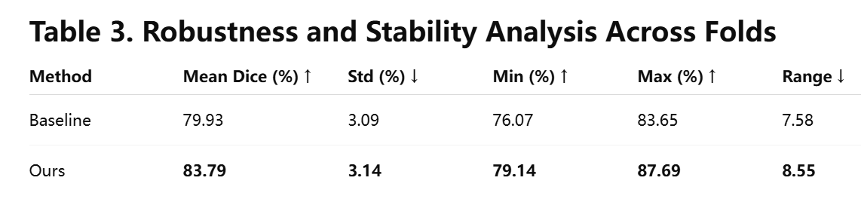

Slide 21
Results Visualization

Slide 22
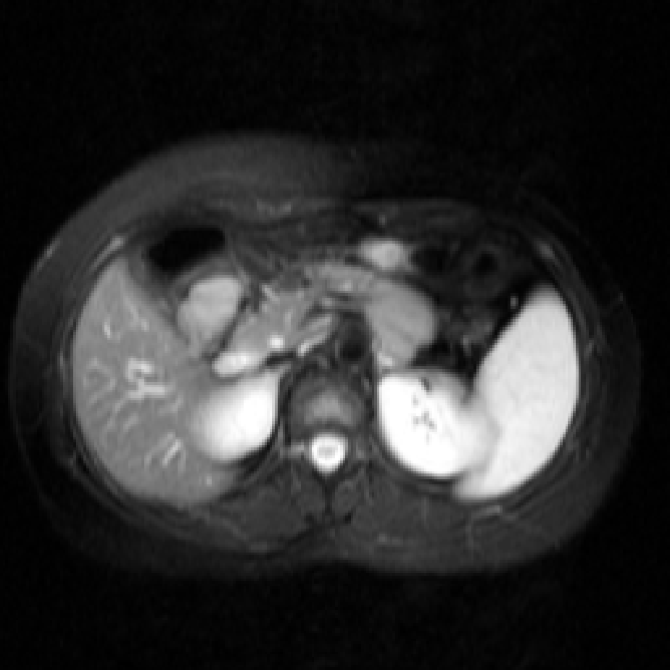
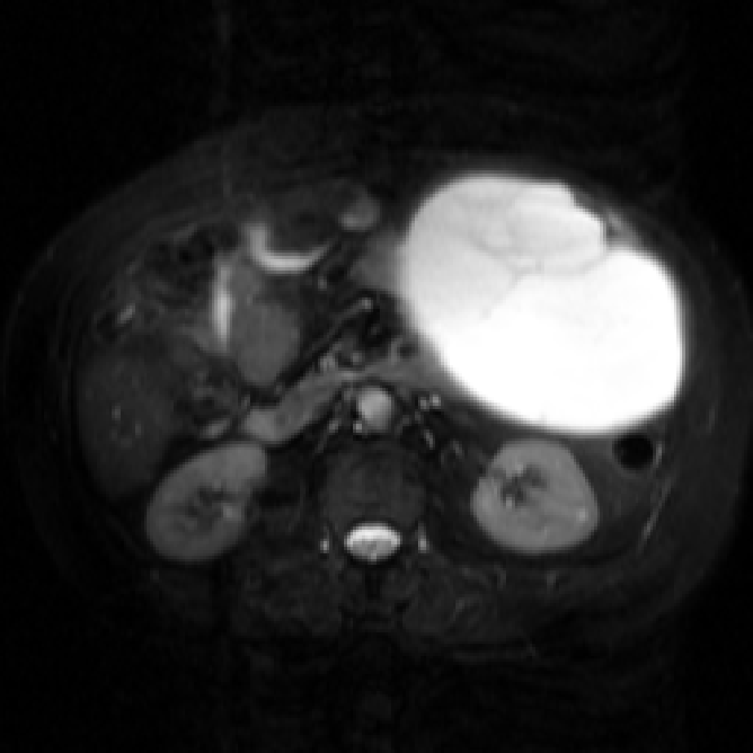
Abdominal cross section (axial view)
The left image shows the baseline segmentation effect, and the right image shows the improved segmentation effect.

Slide 23

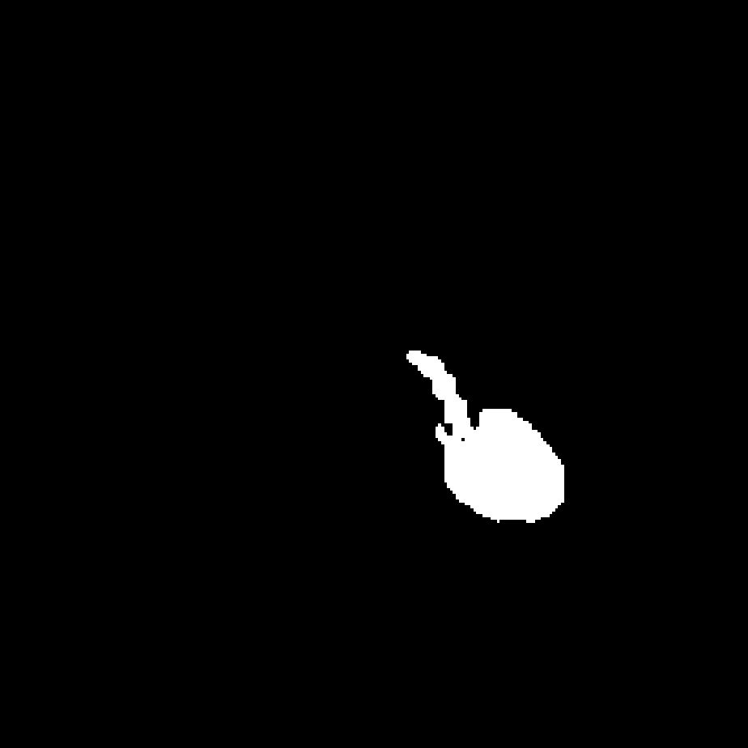
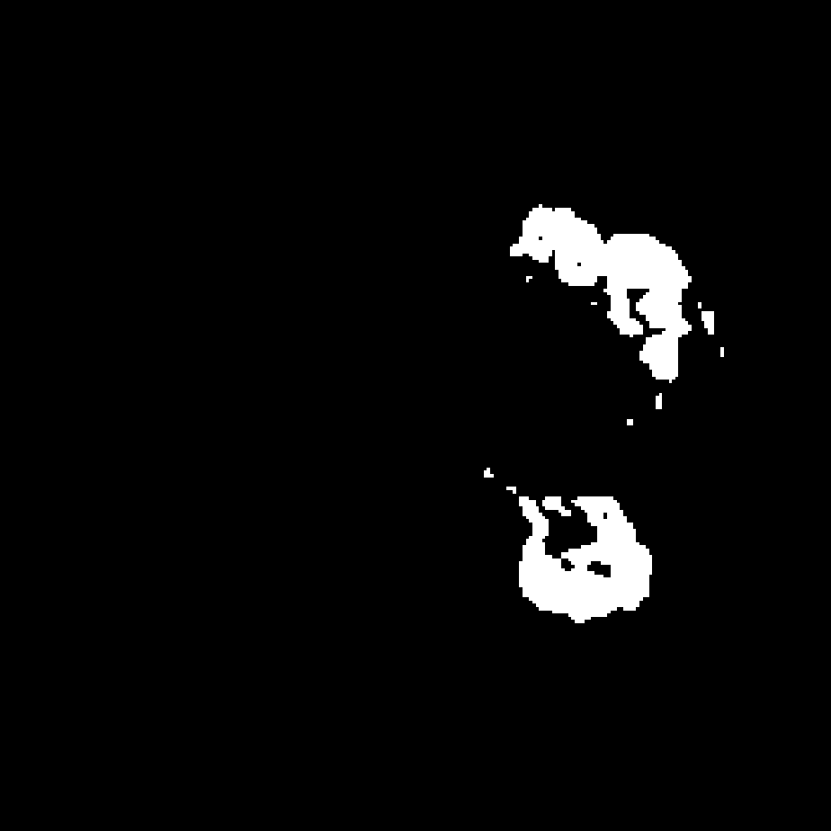
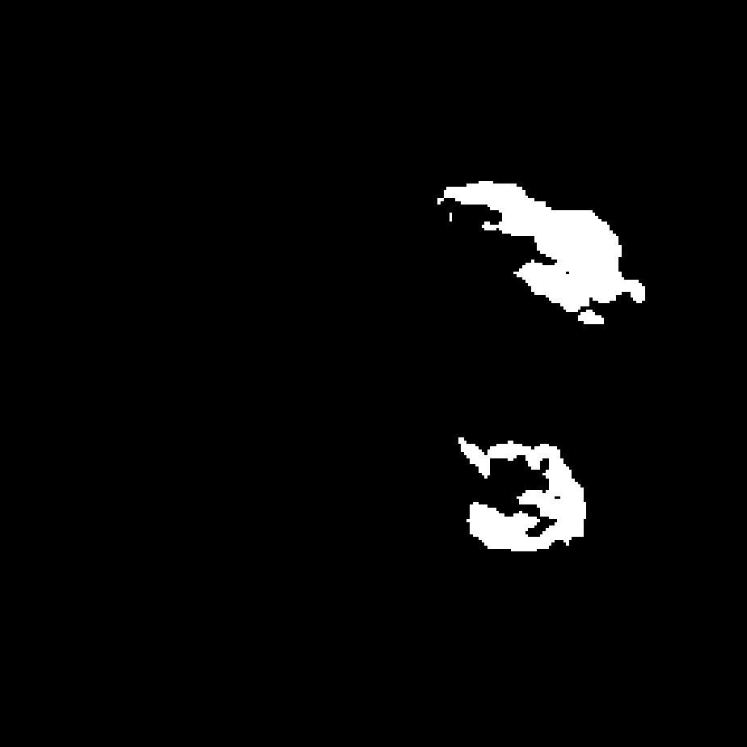
Left kidney
The left image shows the baseline segmentation effect, and the right image shows the improved segmentation effect.
Baseline Ours

Slide 24
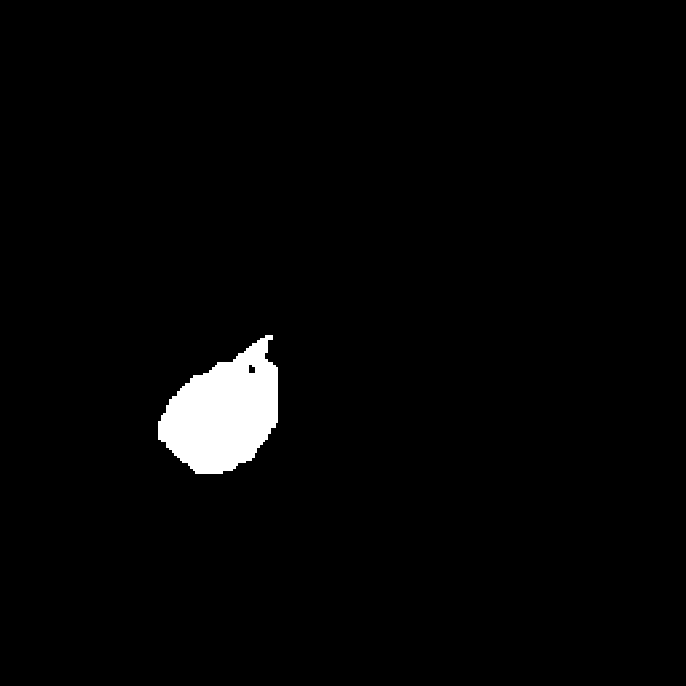



Right kidney
The left image shows the baseline segmentation effect, and the right image shows the improved segmentation effect.
Baseline Ours

Slide 25




Spleen
The left image shows the baseline segmentation effect, and the right image shows the improved segmentation effect.
Baseline Ours

Slide 26
Future Works

Slide 27
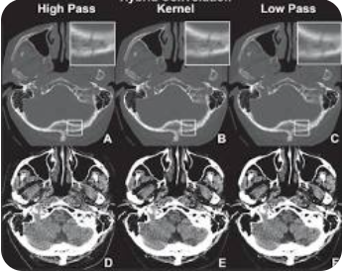
Improvements
For
CT-Scan
CT-Scan image characteristics：
The edges are more blurred.
3D data, Greater continuity of anatomical structure
Information between slices is highly correlated

Slide 28
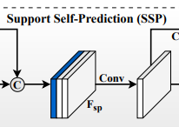
Improvements
For
CT-Scan
Ideas：
Increase supervoxel granularity and slice continuity
Cross-Slice Contextual Attention
Prototype based on a single supporting image
Multi-slice Input
→

